Slide 1
e-Worker hiring System

Slide 2
e-Worker hiring System
Project Guided by : Mrs. Snehal Somavanshi
Project Members
Ms. Harshada Nandawate
Mr. Jayesh Patil
Mr. Pratik Kale
Ms. Komal Dhere

Slide 3
Agenda
Project introduction
Project architecture
Technology platform used for project
User roles and responsibilities
Division of work within team
Details of my contribution
Known issues if any
Future extensions if any
Conclusion

Slide 4
Project Introduction
Purpose of the project
e-worker Hiring system provides a portal for worker employment. Hiring process is controlled by administrator. e-worker Hiring System will play key role in minimizing manual work and errors as well as eliminating worker agents in this entire cycle. It will save much time as well as reduce losses incurred in traditional hiring system.
This recruiting system will end the search for web based worker hiring. Each worker can be identified by the organizational unique id. workers get a chance to quickly react to new request and have employment. In initial phase, the system will be only for specific region.

Slide 5
Need Of Project
There are many existing portals available for hiring employees like naukari.com, Monster etc. where there is no single portal for workers. In current scenario, workers communicate with agent for the employment and have to pay commission to the agent due to this workers do not get fully financial benefit.
In current worker hiring process, worker may lose employment opportunity due to delay in response to the agent. Agent faces shortage of workers and he couldn’t fulfill client’s requirement . Moreover, existing system is much tedious and time-consuming

Slide 6
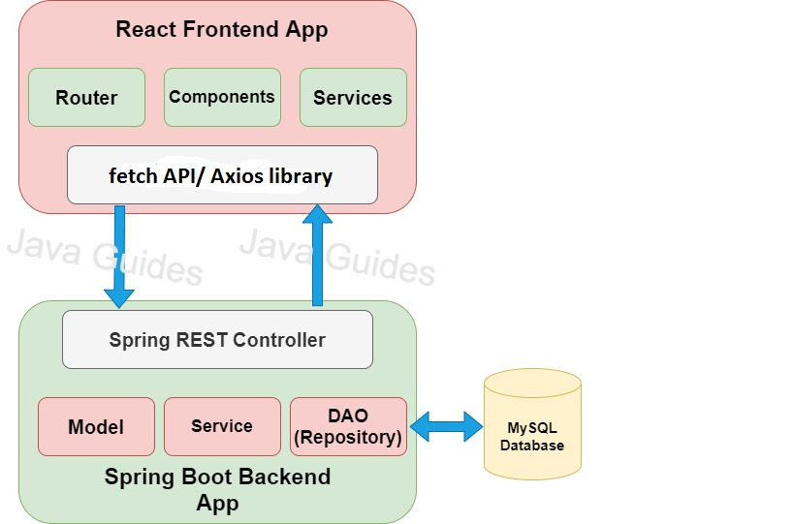
Project Architecture

Slide 7
Technology platform used for project
Technologies used :
Front end : Bootstrap, React JS
Middle tier : Springboot, JPA
Database : MySQL

Slide 8
Reason for selecting specific technologies
React JS :
Provides Reusable Components : ReactJS provides reusable components that developers have the authority to reuse and create a new application. Thereby, reducing the development effort and ensuring a flawless performance.
JavaScript library : A strong blend of JavaScript and HTML syntax is always used, which automatically simplifies the entire process of writing code for the planned project.
Proficient Data Binding : ReactJS trails one-way data binding. This means that absolutely anyone can track all the changes made to any particular segment of the data. This is a symbol of its simplicity.
Virtual DOM : The core of the framework offers a virtual DOM program and server-side rendering, which makes complex apps run extremely fast.

Slide 9
Springboot :
Its main purpose is RAD(Rapid Application Development) i.e. reducing development time as much as possible.
It quickly releases the app in production environment and follows some development model ‘defaults opinionated approach’ i.e. springboot will configure few things automatically.
Springboot comes with embedded tomcat server so there is no any context root and hence application is deployed as self deployable unit.
MySQL :
Follows ACID properties, free of cost- it is open source
syntax easy to understand, scalable

Slide 10
User roles and responsibilities
User roles :
Admin
Client
Worker

Slide 11
Responsibilities for each user
Admin’s responsibilities/privileges
Login
Report Generation
Manage account of users
View user details
Decide Workers wages

Slide 12
Client’s responsibilities /privileges
Register
Login
Place requirement
View requirement status
Edit Profile

Slide 13
Worker’s responsibilities /privileges
Register
Login
Accept/Decline request
Edit profile

Slide 14
Details of my contribution
We have developed by contributing equally a web application in which we have worked on both frontend and backend.
First of all we completed documentation part by making BRS and SRS document, ER diagram, zero-level DFD.
After completing documentation we moved on for creating database and then further worked on server side and simultaneously on front end for registration and login purpose.
We have stored our source code and all documents related to application on git repository.

Slide 15
Known issues if any
In react using fetch() we were not able to send request to the server.
-To overcome this hurdle, we used axios library.
While placing the requirement illegalArgumentException occurred at server side.

Slide 16
Future extensions
Payment module can implement
This system can be implemented at global level
Our platform will be available in state languages.

Slide 17
Benefits of these implementations
Payment record can be maintained.
We can make payments online.
Users can use this system at state level.

Slide 18
Conclusion
e-Worker Hiring System helps workers for getting employement without paying commission to the third party agents.
Our System provides a very user-friendly platform registration system where clients can easily place their requirements and workers who want to have employement can easily reach to clients in their region.

Slide 19
Thank you

